Slide 1
Angular UI Development
Debojyoti majumder

Slide 2
Basics of AngularJS 1.x version
AngularJS is a JavaScript framework that help us to build web application
AngularJS 1 was released in October 2010
It’s an open source product
It’s a product of Google .
Download AngularJS
https://angularjs.org/
https://www.madewithangular.com/

Slide 3
Characteristics of AngularJS 1.x version
Dependency Injection
Two Way Data-Binding
Testing
Model View Controller
Directives, Filters etc…
Services
Model
View

Slide 4
Some Common Concepts and Terminology- AngularJS 1.x and Angular
Template - HTML with additional markup used to describe what should be displayed.
Directive - Allows developer to extend HTML with own elements and attributes (reusable pieces).
Scope - Context where the model data is stored so that templates and controllers can access.
Compiler - Processes the template to generate HTML for the browser.
Data Binding - Syncing of the data between the Scope and the HTML (two ways).
Dependency Injection – A concept which help us for Fetching and setting up all the functionality needed by a component.
Module - A container for all the parts of an application.
Service - A way of packaging functionality to make it available to any view.

Slide 5
AngularJS,Angular2 and Angular4
AngularJS vs Angular2
Angular 2 is not a simple upgrade from AngularJS 1
Angular 2 vs Angular 4
Changing from Angular 2 to Angular 4 and even the future version of Angular, won’t be like changing from AngulaJS1.x version.
In case of Angular4 ,changes are done into core library part.
Angular4 is simply the next version of Angular 2.
Angular 4 is backwards compatible with angular 2 for most application.
Changes :
TypeScript 2.1 and 2.2 compatibility .
@angular/core package.

Slide 6
Angular 6 new features
Change-1
Import from “@angular/core” vs Import from “@ angular/animations”
Earlier it is possible to import animation related functions from “@angular/core” but now to import animation related function you should import “@angular/animations” package.

Slide 7
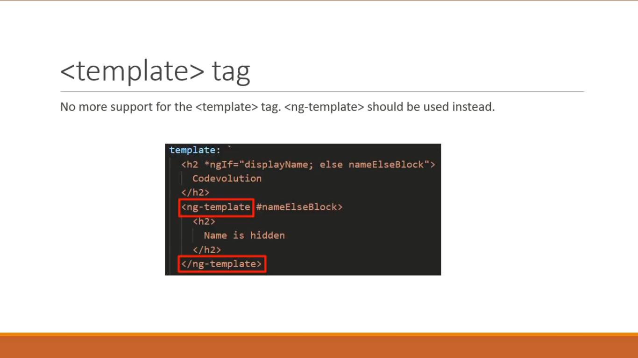
Change-2

Slide 8
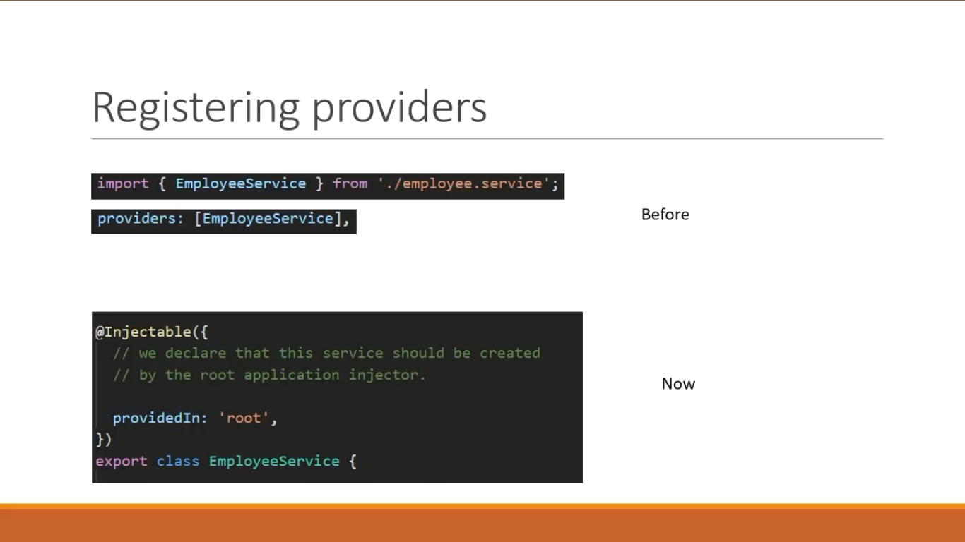
Change-3

Slide 9
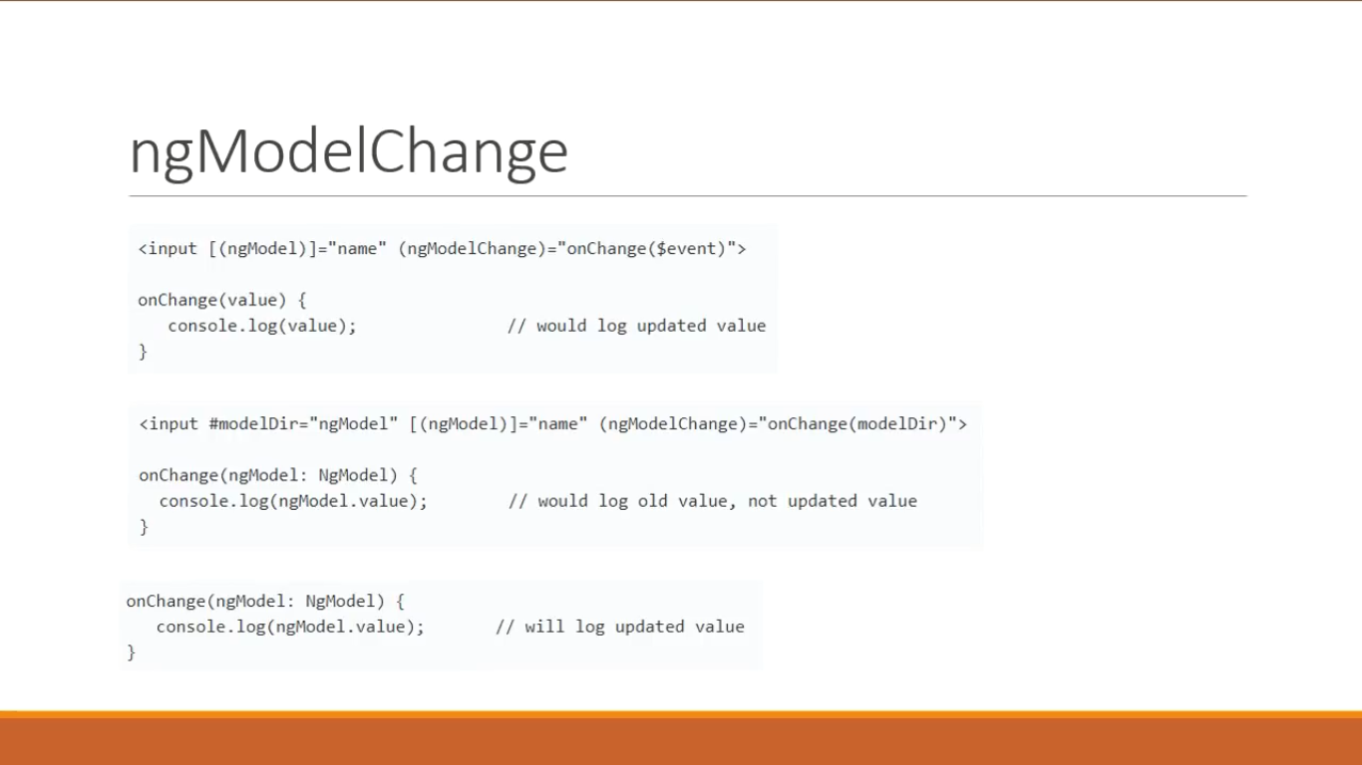
Change-4

Slide 10
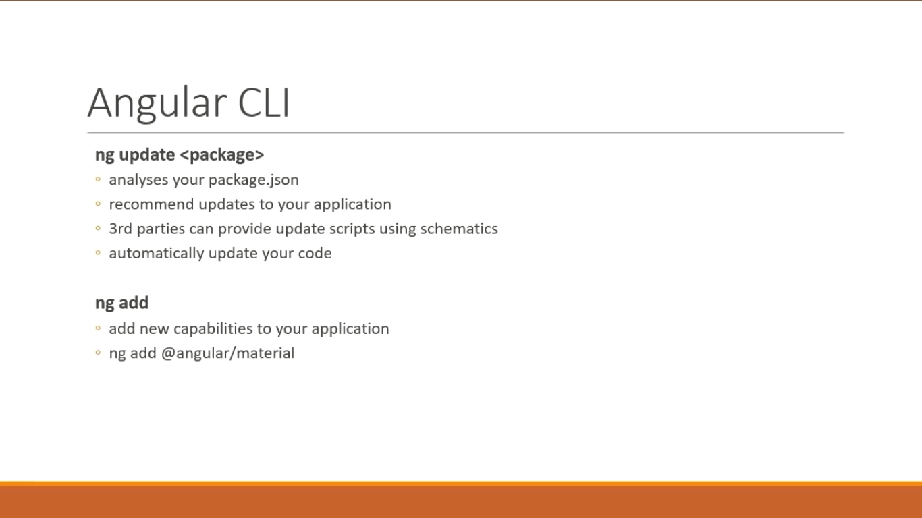
Angular CLI 6.0.0 –new commands

Slide 11
Naming guidelines
Use “AngularJS” to describe versions 1.x or earlier.
Use “Angular” to describe versions 2.0.0 and later.
Use the version numbers like “Angular 4.0” or “Angular 2.4” only when we need to talk about a specific release.
Otherwise try to use “Angular” word to describe any version of Angular 2 and later.

Slide 12
Why Angular 2
Performance: Angular is 5 times faster compared to AngularJS 1.x
Not Only just performance of angular but it has got other improved features such as-
Improved modularity
Testability
Dependency injection
Mobile Support: By using Angular 2 we can build a single application that works across mobile and desktop devices.
Component based development : In case of angular 2 ,everything is component, rather you can say that components are the basic building-blocks of angular 2 Application.
Advantages:: Code reuse, Testing using component is better approach,.
Angular 2 itself, is built using TypeScript, TypeScript has great support of ECMAScript6 standard.

Slide 13
ECMAScript & Angular version
The JS language standard is officially known as ECMAScript.
Transpilation compiles ECMAScript6 to ECMAScript5.
New features in ECMAScript2015 are – Classes , Modules , Arrow functions etc.
Different Angular version ::
AngularJS 1.x - 2010
Angular 2 - 2016
Angular 4 - 2016 Dec
Angular 5 – 2017 Nov

Slide 14
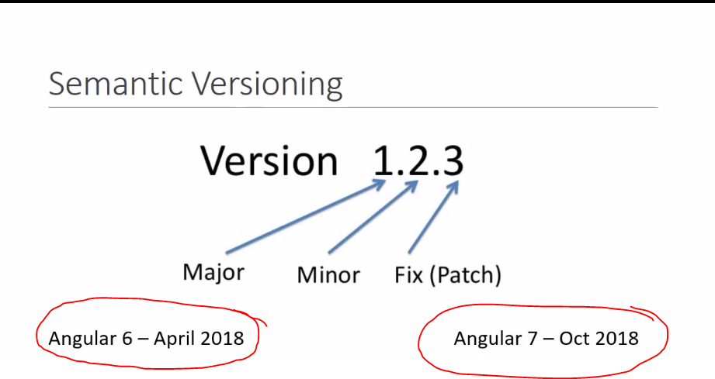
Angular version releases
In general, we can expect the following release cycle:
A major release every 6 months.
1-3 months minor releases for each major release.
A patch release almost every week.

Slide 15
What is TypeScript
TypeScript is a strongly typed, object oriented, compiled language.
Free and open-source PL developed by Microsoft.
It was designed by Anders Hejlsberg (designer of C#) at Microsoft.
TypeScript is both a language and a set of tools.
Superset of JS.
TypeScript is a typed superset of JavaScript compiled to JavaScript.
In other words, TypeScript is JavaScript plus some additional features.
Transpilation compiles TS to JS.

Slide 16
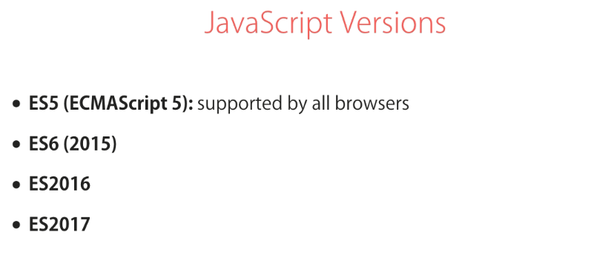

Slide 17
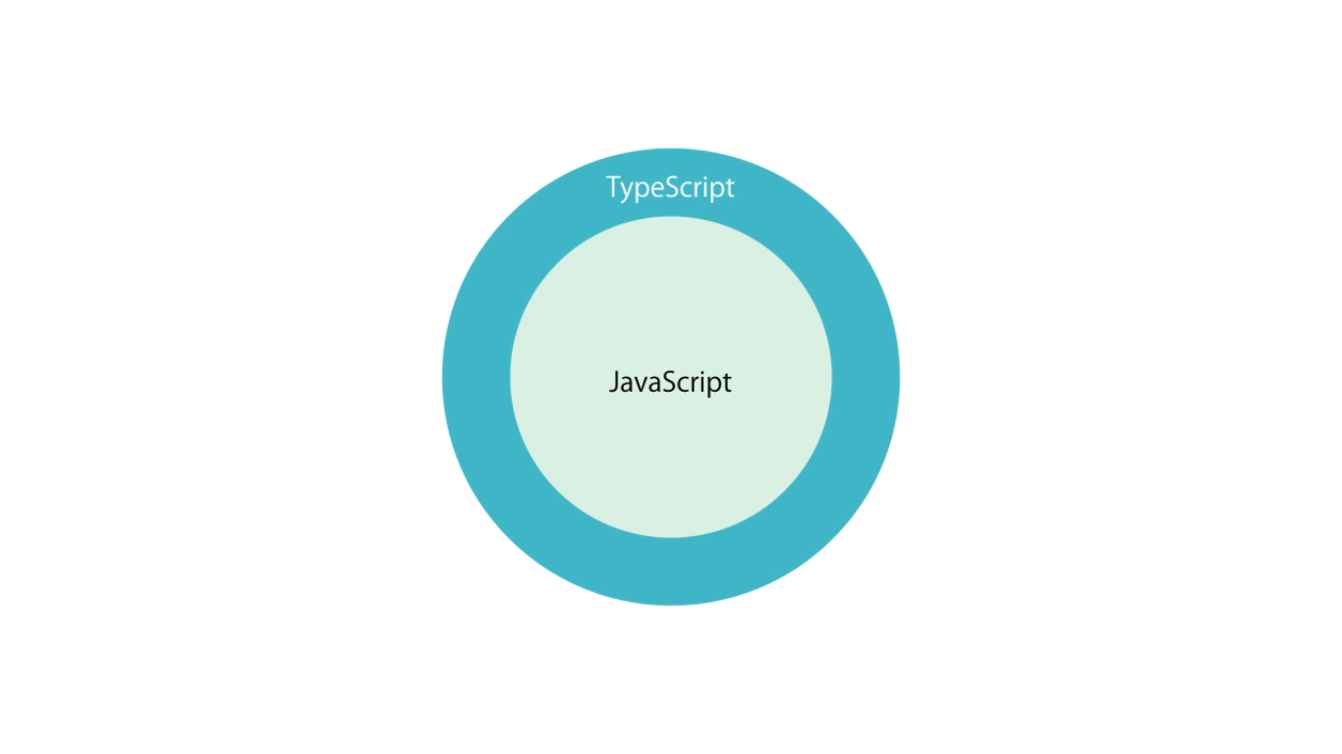
Type-script(TS) is a super-set of Java-script(JS)

Slide 18
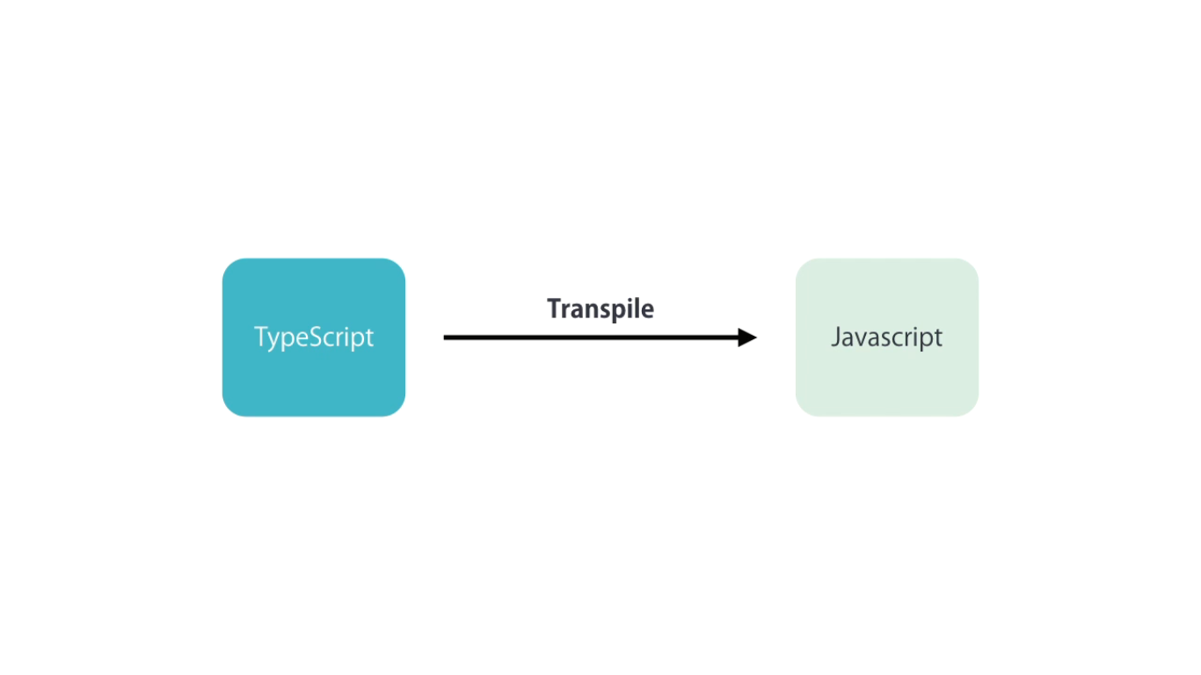
We need to transpile TS to JS

Slide 19
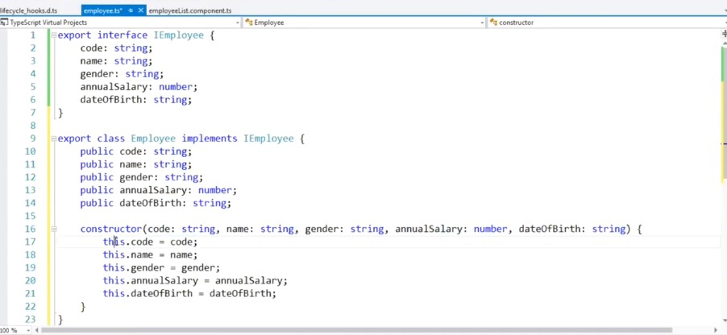
Interface in Angular
Like any other oop concept here also interface is an abstract type ,
It only content declaration of properties, methods, events
Implementation of the interface member is provided by a class

Slide 20
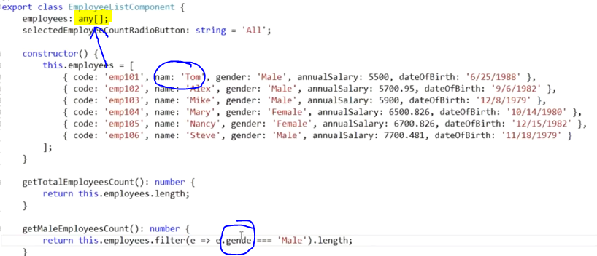
Due to weekly type
Due to weekly type data declaration
i)We do not get any intelligence that’s why any developer can misspelled property name.
Any typographical error may occur at run-time because compile-time compiler do not notify any-thing.

Slide 21
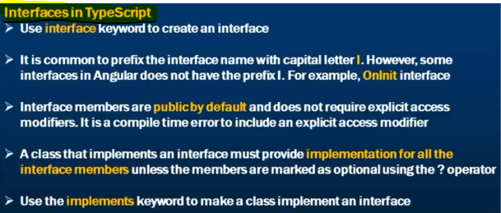
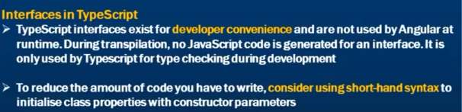
About: Interface in TypeScript

Slide 22
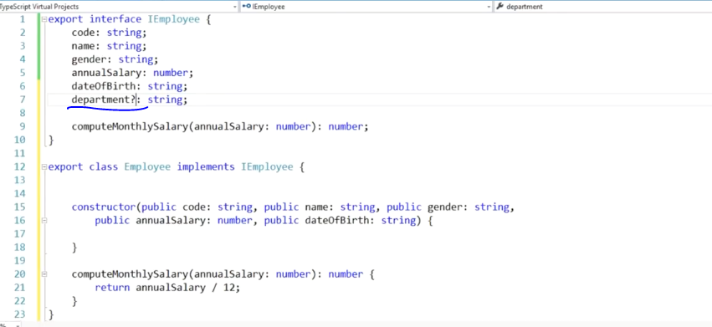

Slide 23
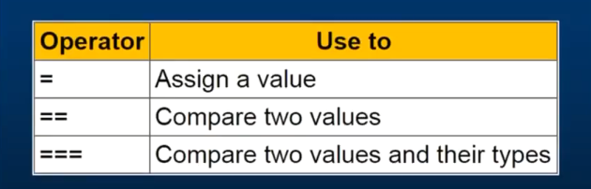
Use of operator in Type-script

Slide 24
Development Environment
node
npm
angular CLI
Text Editor – VS Code or Notepad++ or any text editor

Slide 25
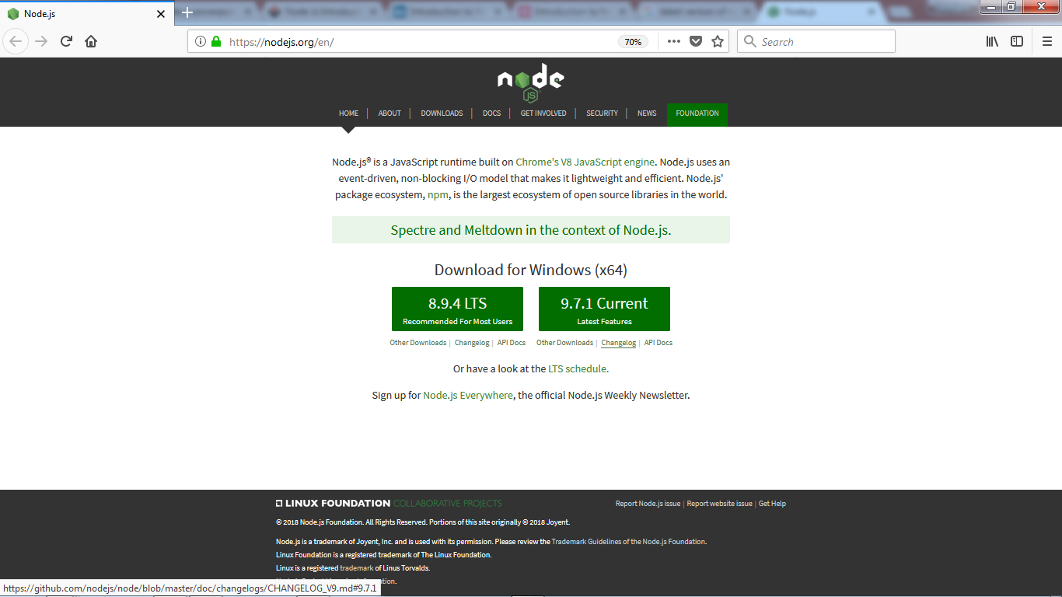
How to download and install node
Download link :
https://nodejs.org/en/

Slide 26
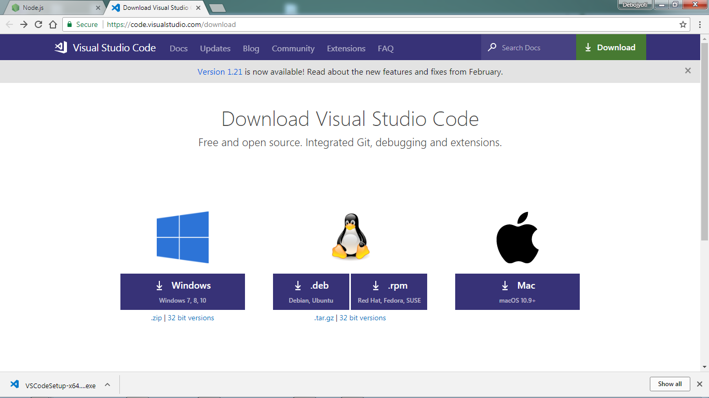
How to download and install VS code
Download link :
https://code.visualstudio.com/download

Slide 27
Getting started with Angular version 2/4/5/7
Prerequisites
Before we begin, make sure our development environment includes Node.js® and an npm package manager.
Node.js
Angular requires Node.js version 8.x or 10.x.
npm package manager
npm –v and node -v
Step 1: Install the Angular CLI
npm install -g @angular/cli
Step 2 : Create a workspace and initial application
ng new my-app
Step 3: Serve the application
cd my-app
ng serve - -open or ng serve
Step 4: Edit your first Angular component
Step 5: ng serve - - port 4400 // If u want to change the default port to another port

Slide 28
Some topics
ECMAScript 2015-Classes,Modules etc
Node Package Manager
npm , short for Node Package Manager, is two things: first and foremost, it is an online repository for the publishing of open-source Node.js projects; second, it is a command-line utility for interacting with said repository that aids in package installation, version management, and dependency management.

Slide 29
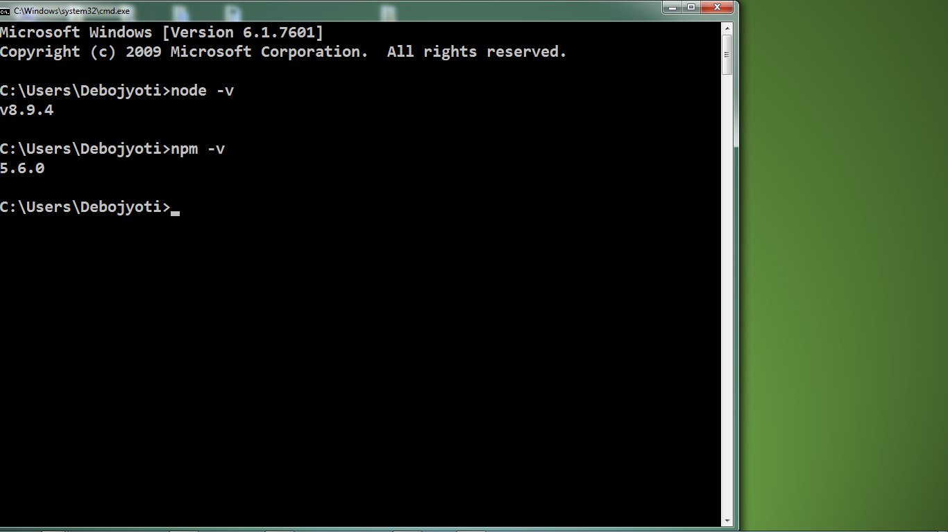
Check installation status!!
By using Command Prompt window
node - -version or node –v
and
npm - - version or npm –v

Slide 30
Components in Angular
Component can be describes as a Class in Angular.
Component is a class with a decorator and a template.
Component composed of three things :
Class
Template
Decorator
Class contains the code required for the template design.
Template define the UserInterface. It contain html part,directives,data bindings.
Decorator adds meta data to the class.

Slide 31
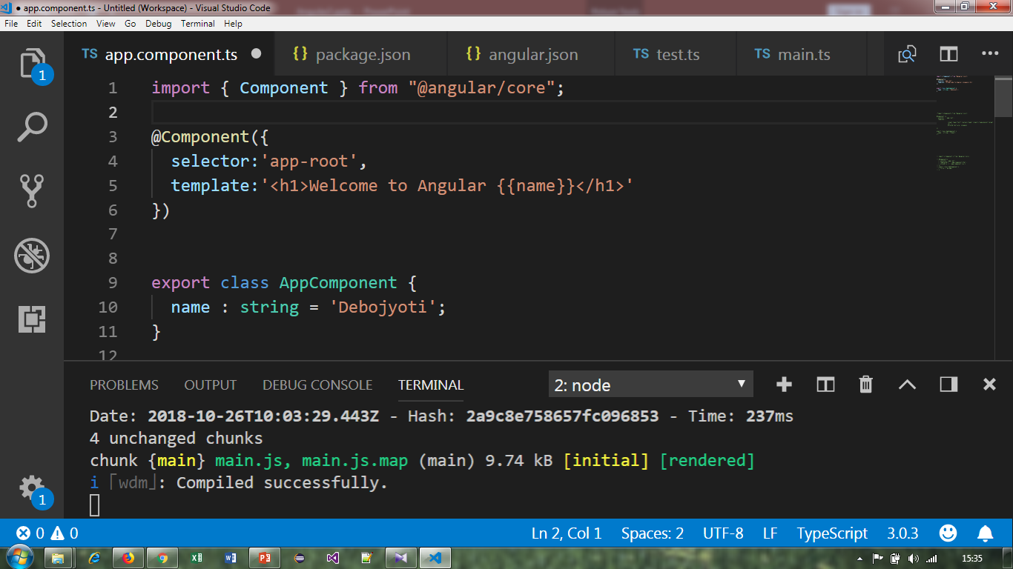
My First Angular Application

Slide 32
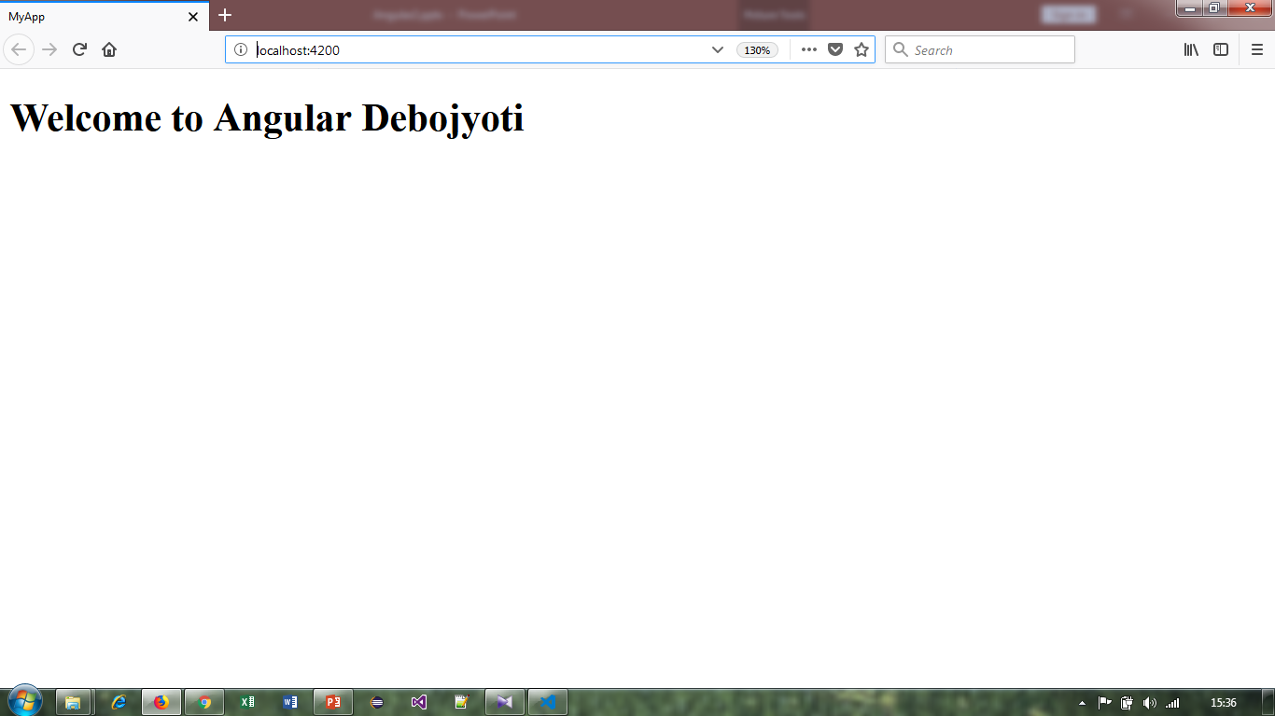
Output :

Slide 33
Single Quote /double Quote and Backtick Character
If we have single line html code in our template property than we can use single quote ,double quote and backtick character .
But if we have html code with more than one line or multiline than we can only use backtick character.

Slide 34
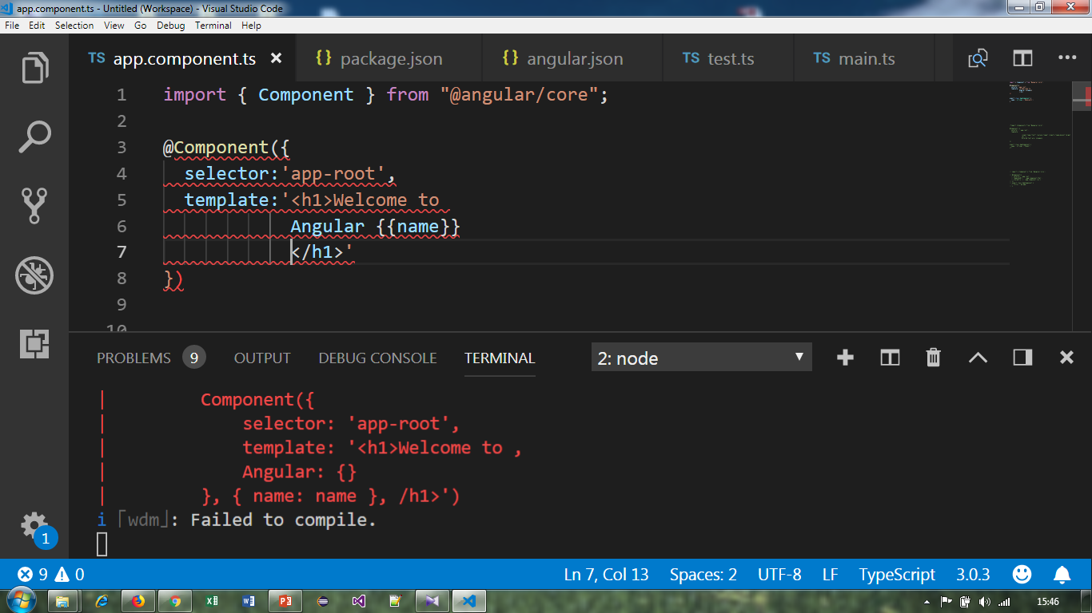
Difference between Single Quote and Backtick Character :

Slide 35
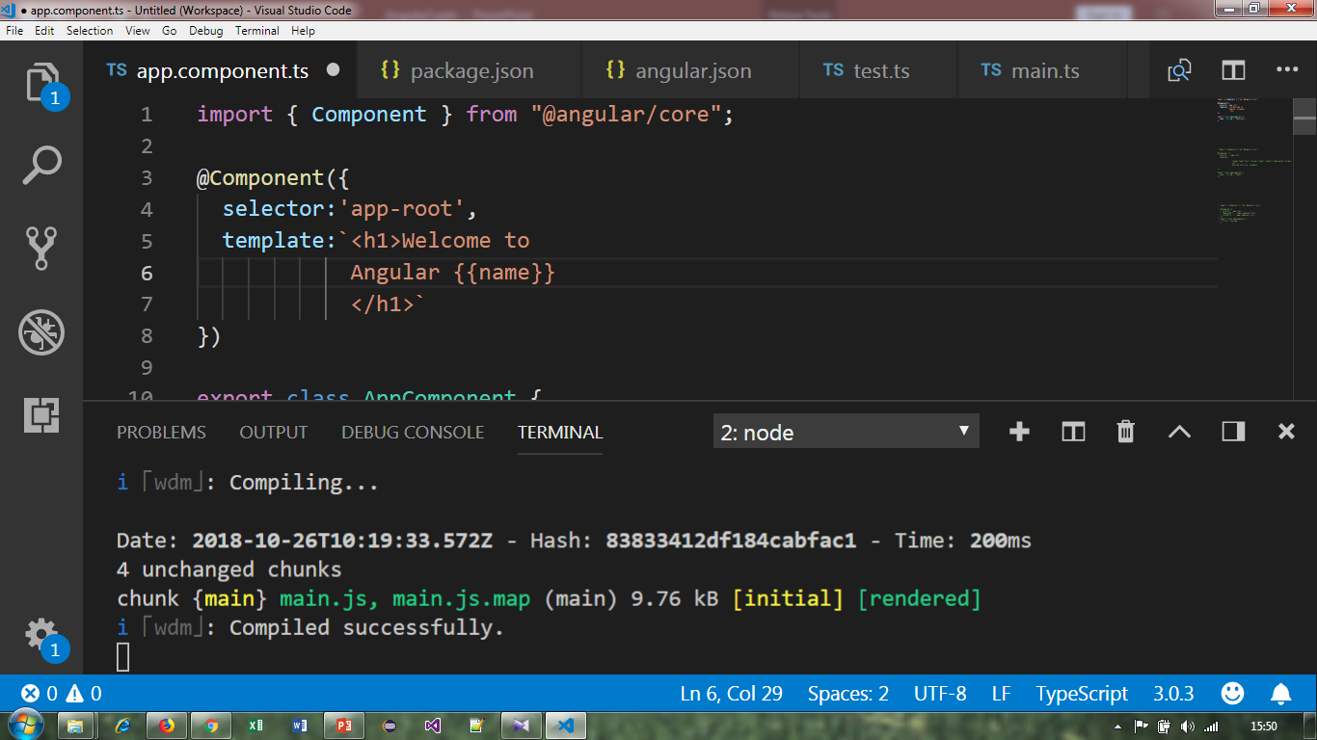
Use of “Backtick”(``) character :

Slide 36
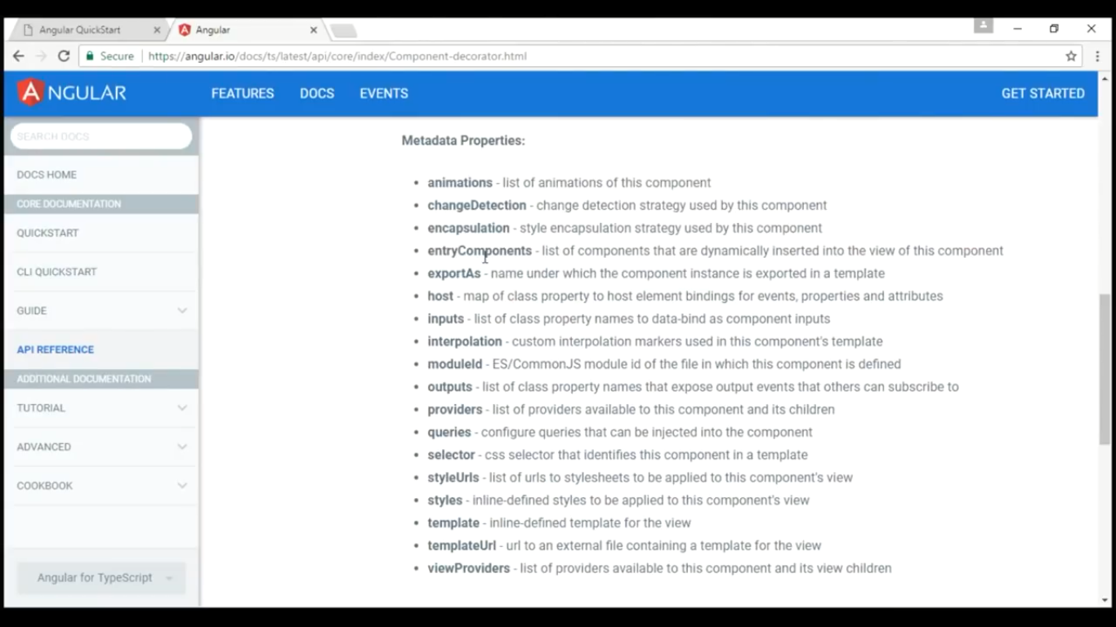
Metadata properties for Component Decorator

Slide 37
template vs templateUrl

Slide 38
template and templateUrl
template : - An inline template for an angular component. If provided, do not supply a template file using templateUrl.
Example→ template: string
templateUrl : - The URL of a template file for an Angular component. If provided, do not supply an inline template using template.
Example→ templateUrl: string
Inline templates are specified directly in the component using template and it is more complex for bigger templates. As per expert suggestions, use templates and styles into a separate file, when your code more than 5 to 10 lines.

Slide 39
Continue…
External templates define the HTML in a separate file and reference this file in templateUrl.
To use a relative path in the templateUrl we must include import component form @angular/core.
Some befits for template Urls i.e.
i) Separations of code
ii) Easy debugging

Slide 40
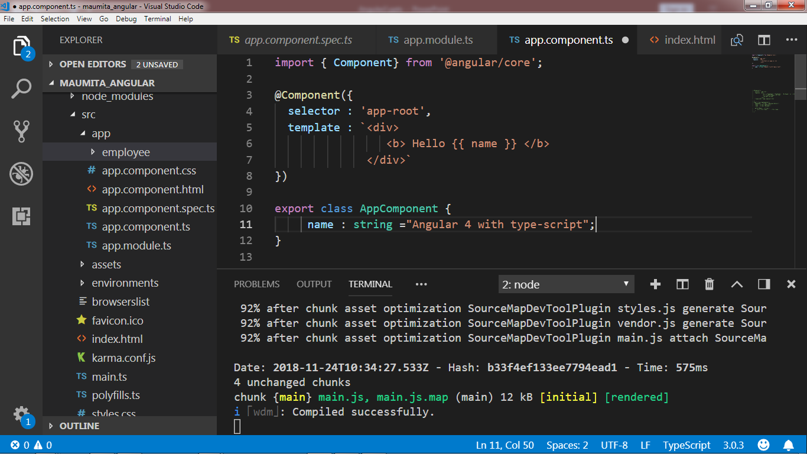
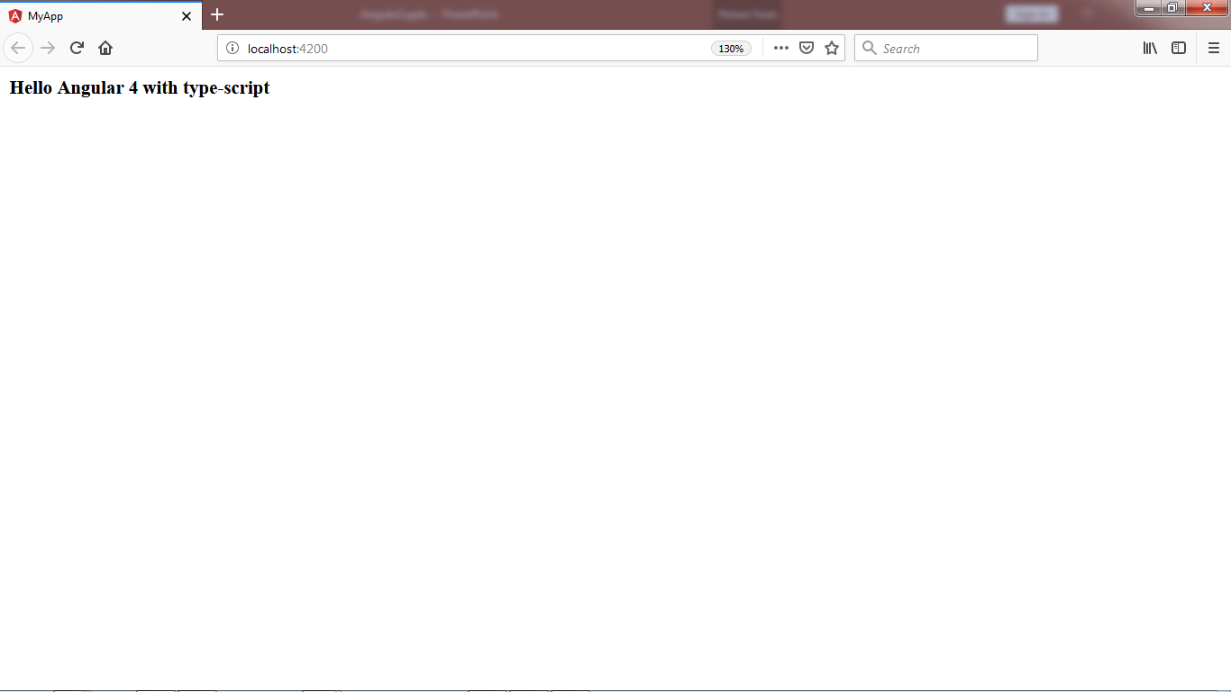
Example : 1 [ template property ]

Slide 41
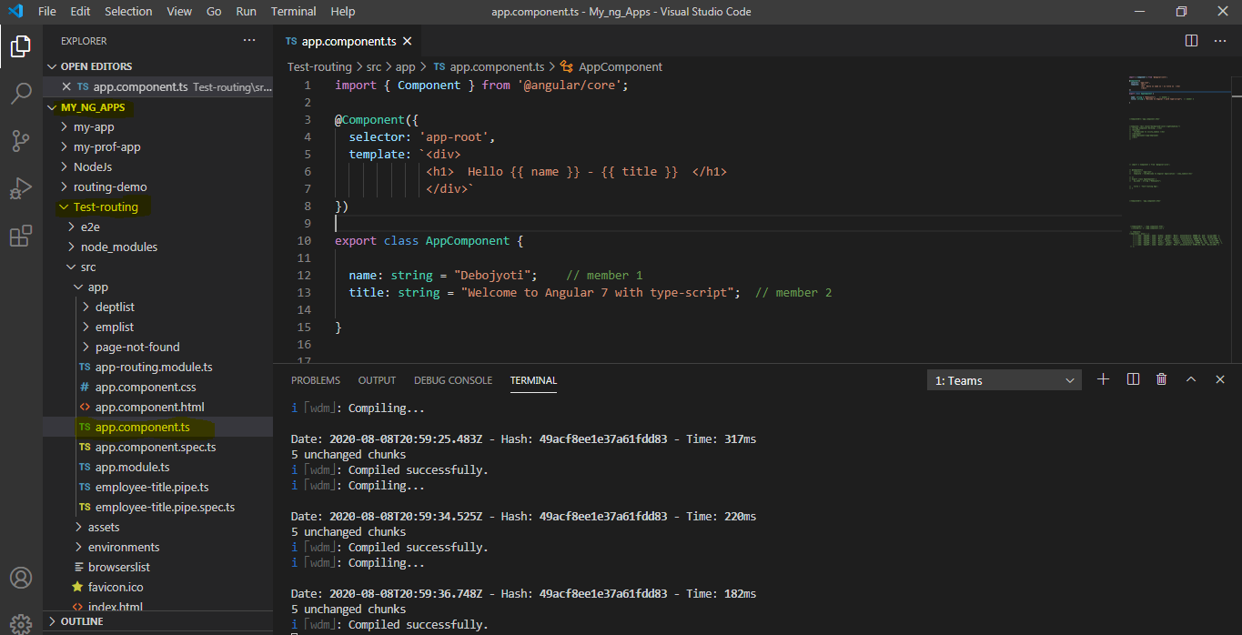
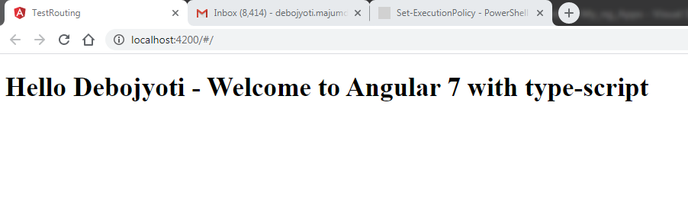
Example : 2 [ template property ]

Slide 42
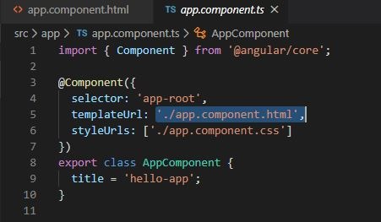
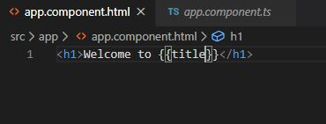
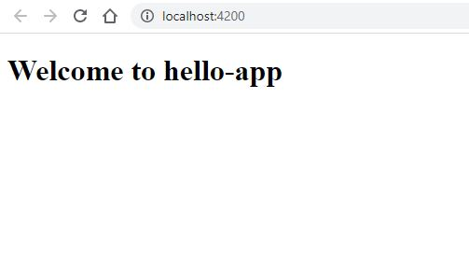
Example : 1 [ templateUrl property ]

Slide 43
Nested components in angular apps

Slide 44
Nested component
Nesting component means including a component into another component.
AppModule : AppModule is the root module which bootstraps and launches the angular application.

Slide 45
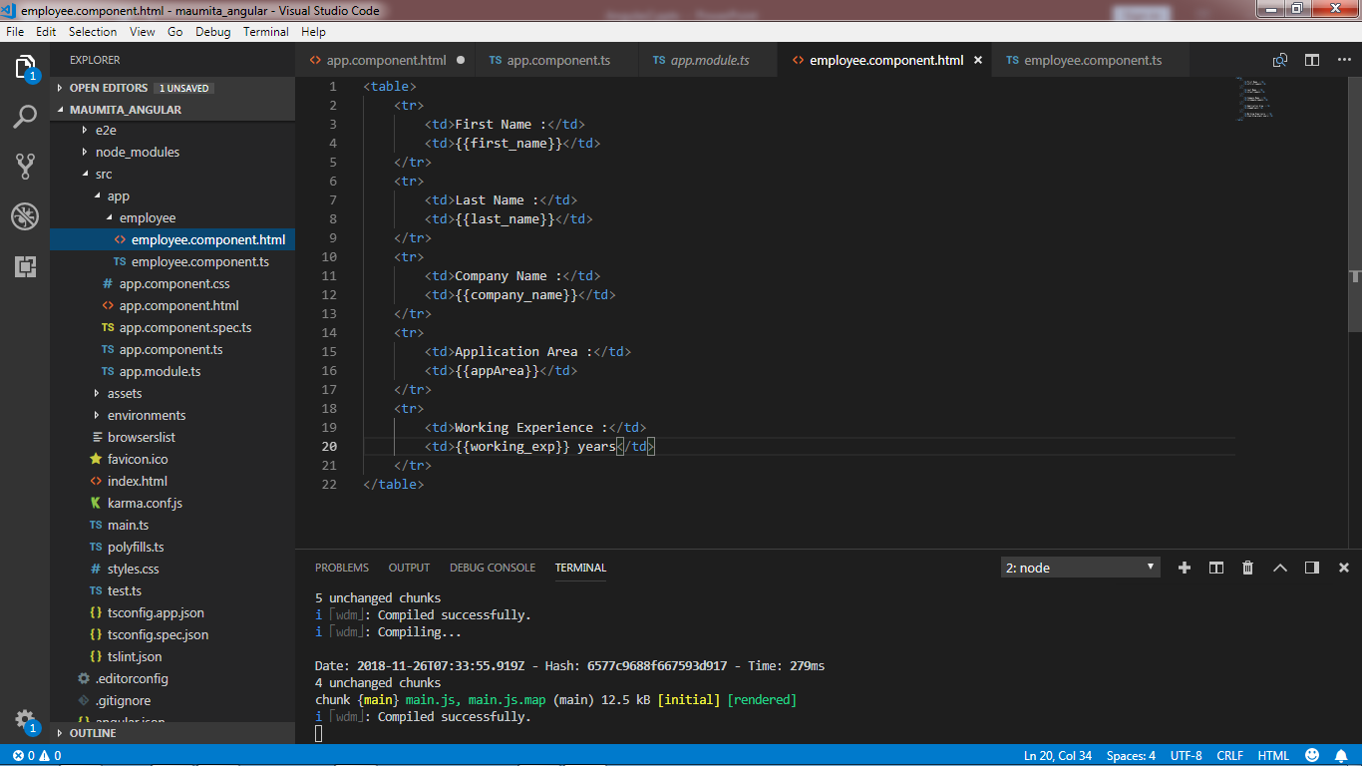
Steps to implement nesting component
Step 1:-Create an new templete file (example→ employee.component.html)

Slide 46
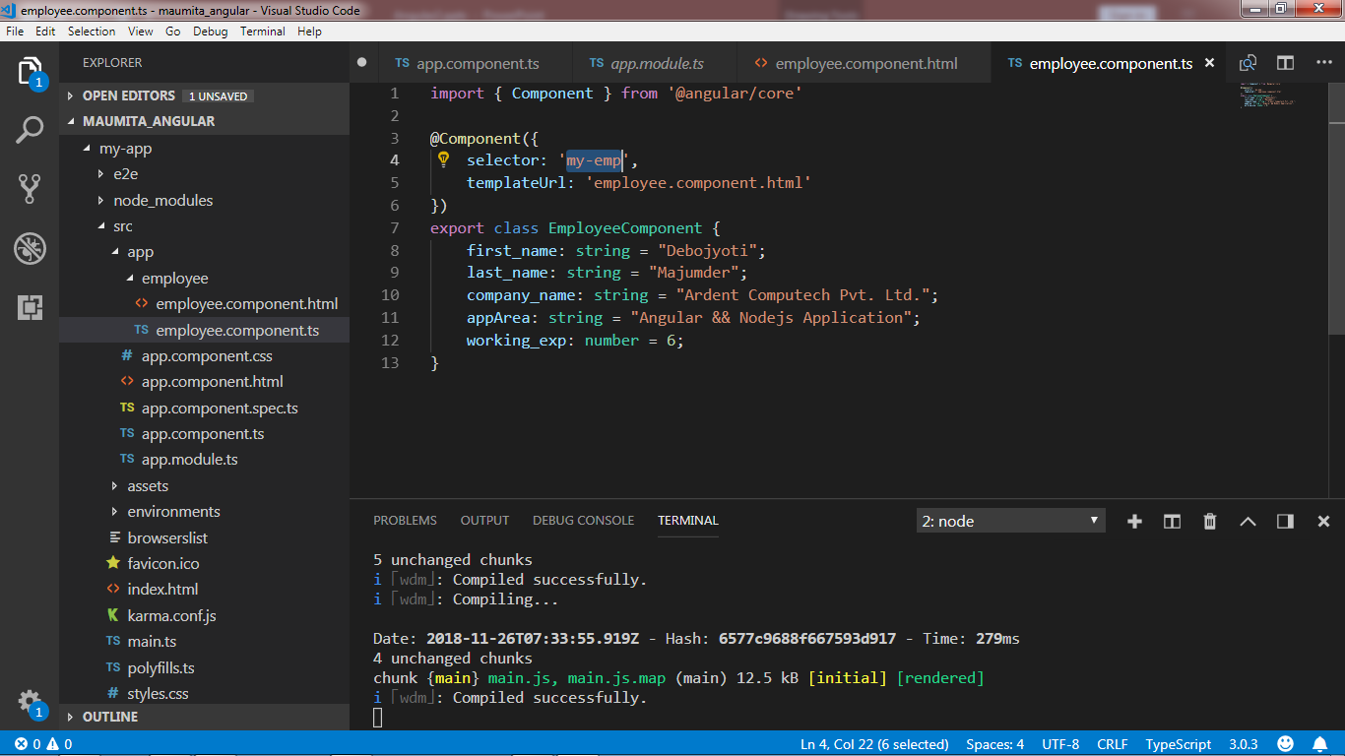
Step 2:- Create an new type-script file (example→ employee.component.ts)

Slide 47
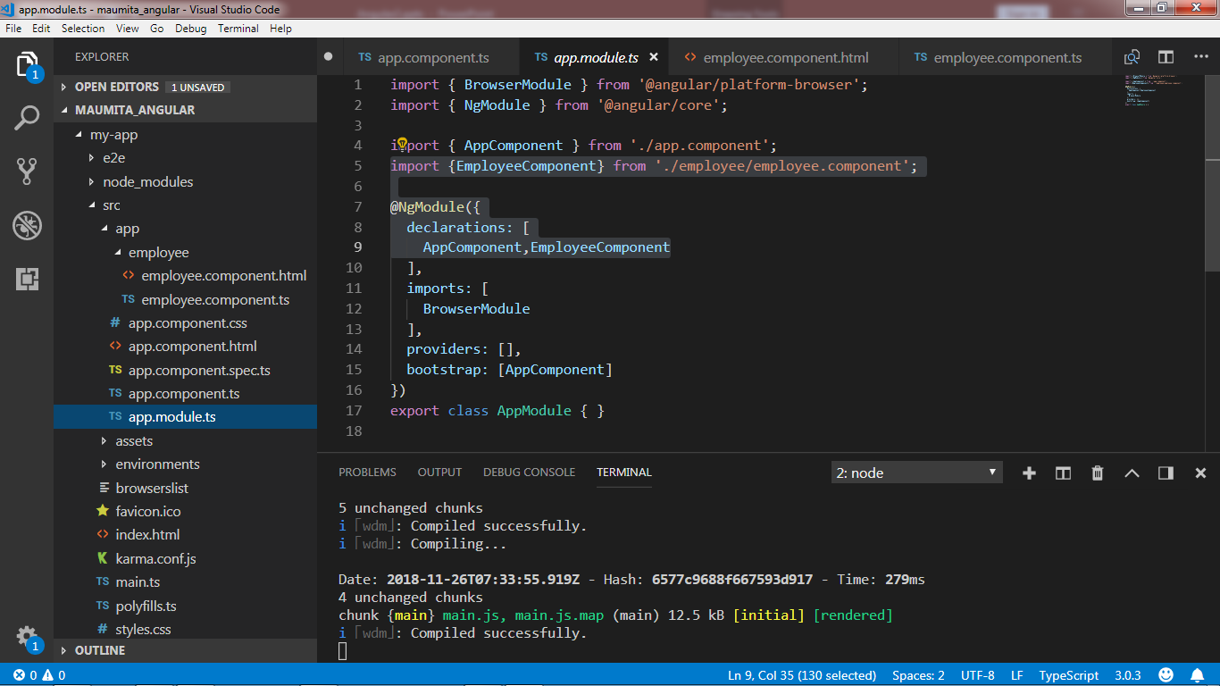
Step 3:- Modification required into app.module.ts

Slide 48
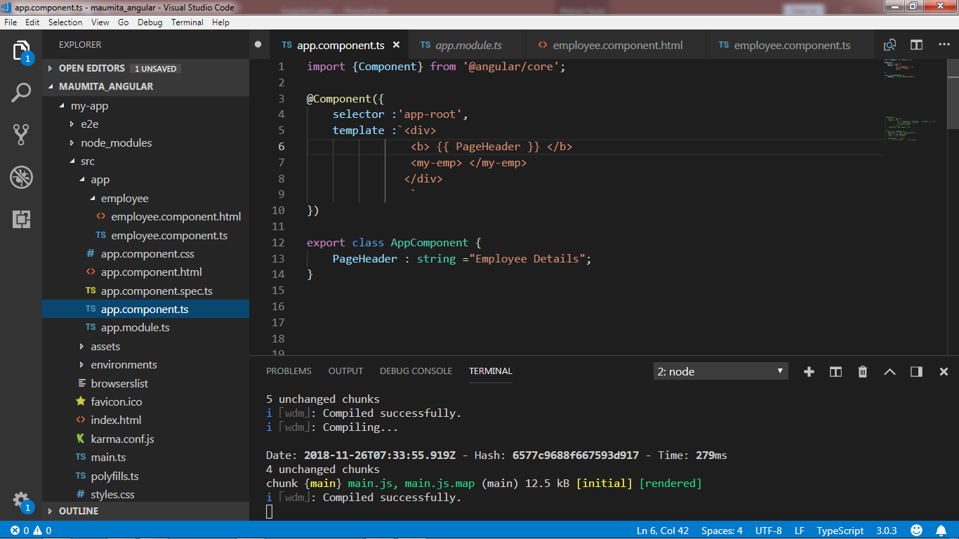
Step 4:-Finally app.component.ts

Slide 49
Styling angular components

Slide 50
Option for styling angular component
Styles in external stylesheet → styles.css.
Styles inline in the component HTML file.
Styles in the component html file using <style> tag.
Specify the styles using the @component decorator styles property.
Specify the styles using the @component decorator styleUrls property.

Slide 51
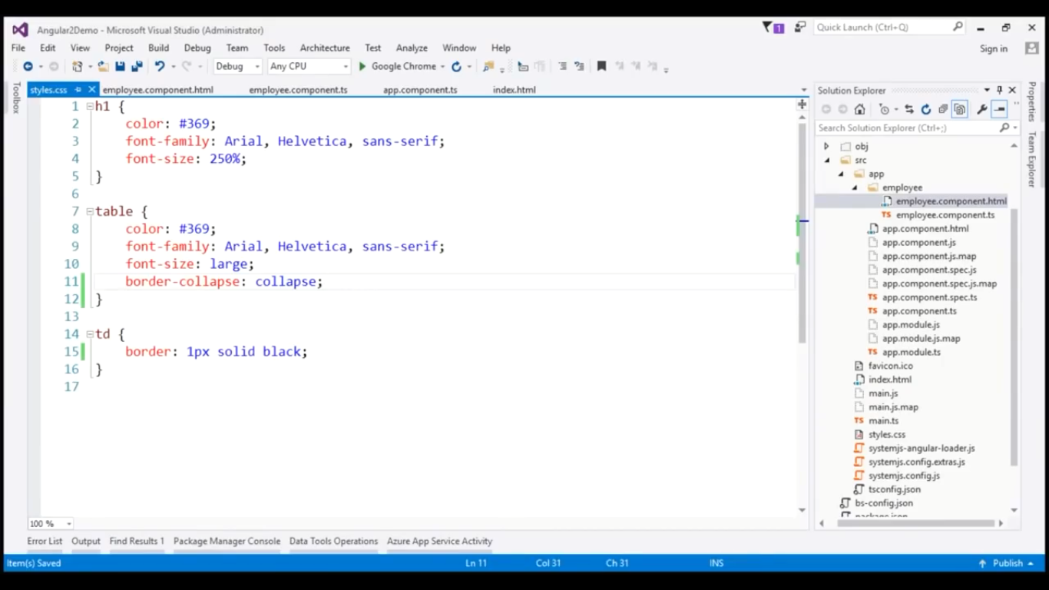
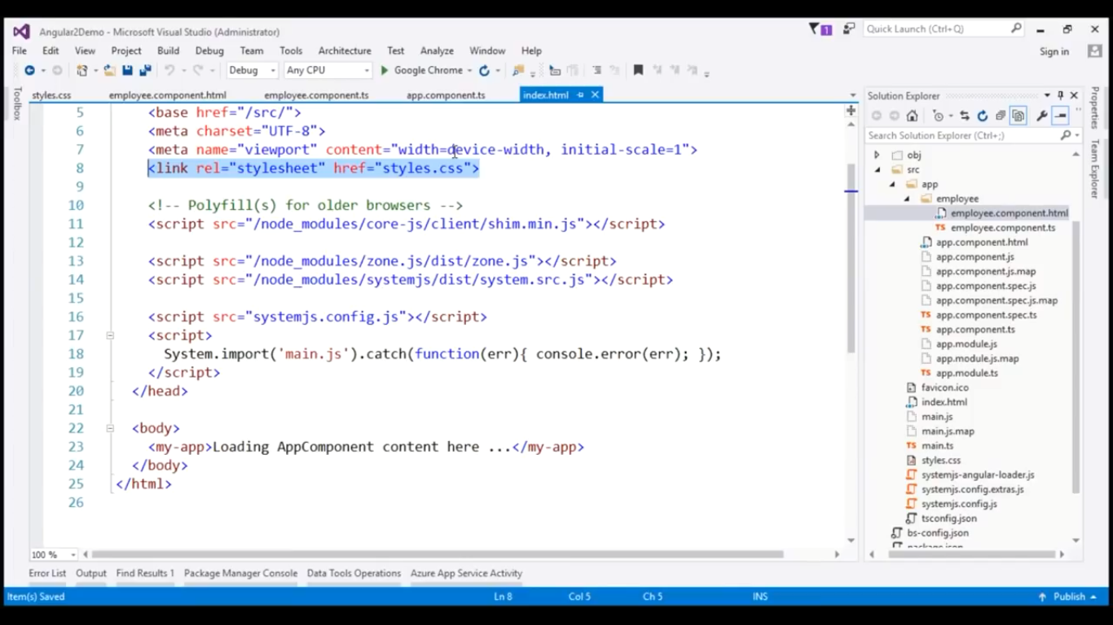
Example 1:- Styles in external stylesheet → styles.css.

Slide 52
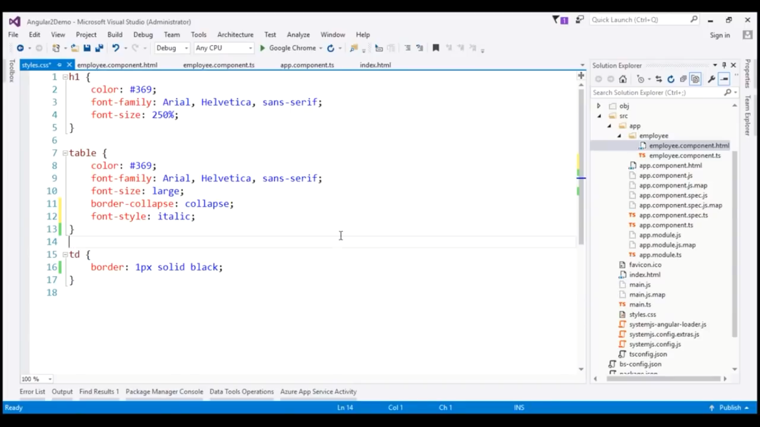
Example 2:- Styles in external stylesheet → styles.css.

Slide 53
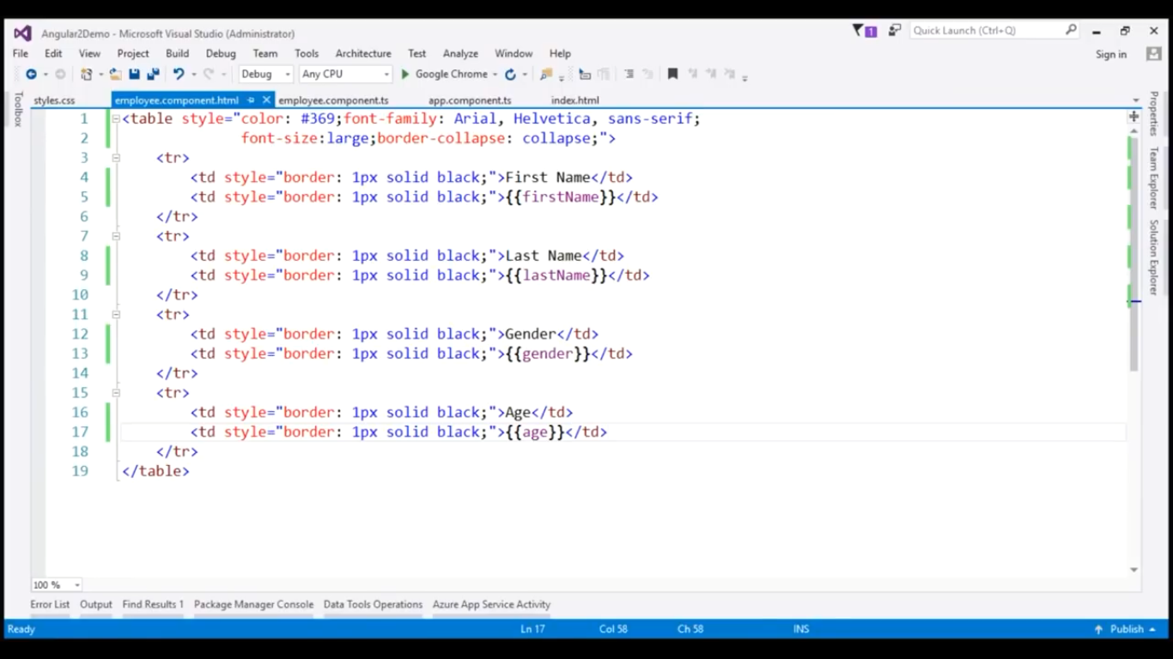
Example 1:- Styles inline in the component HTML file

Slide 54
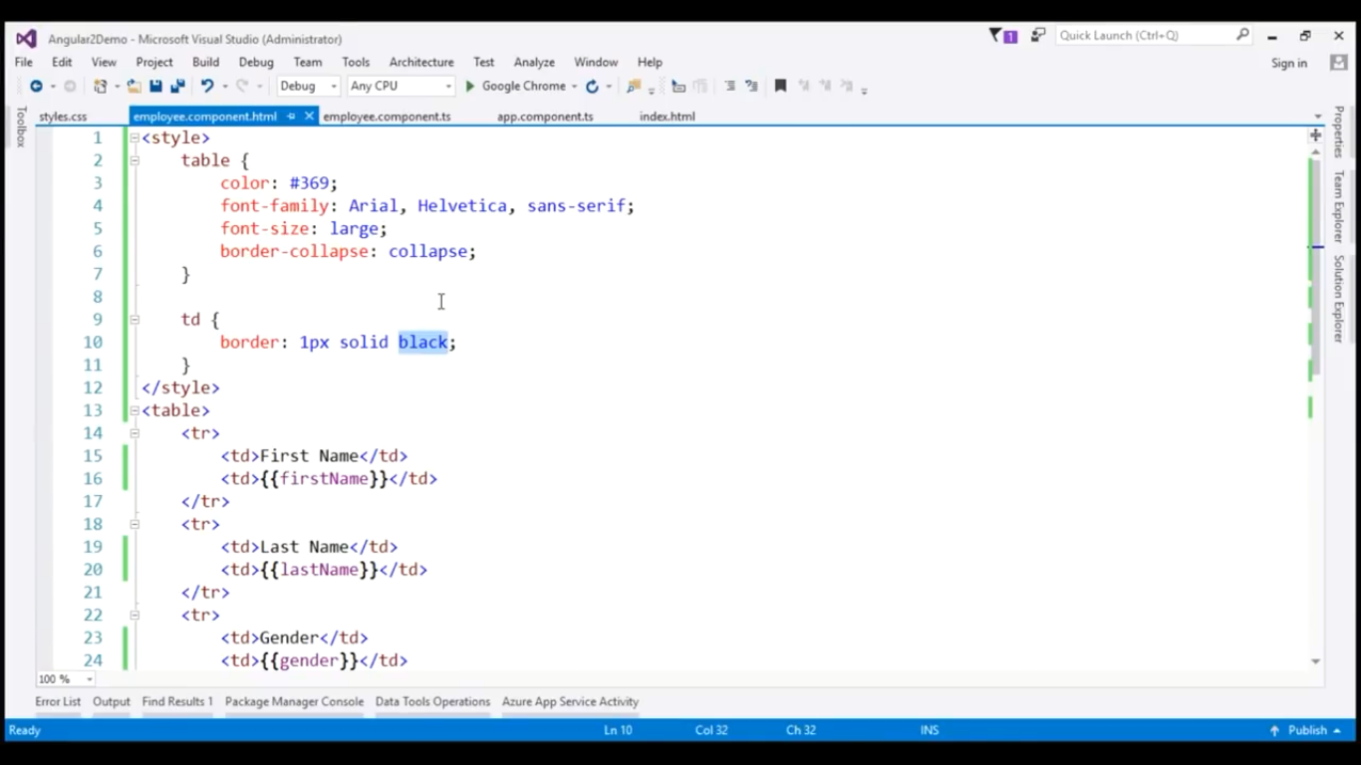
Example 1:- Styles in the component html file using <style> tag

Slide 55
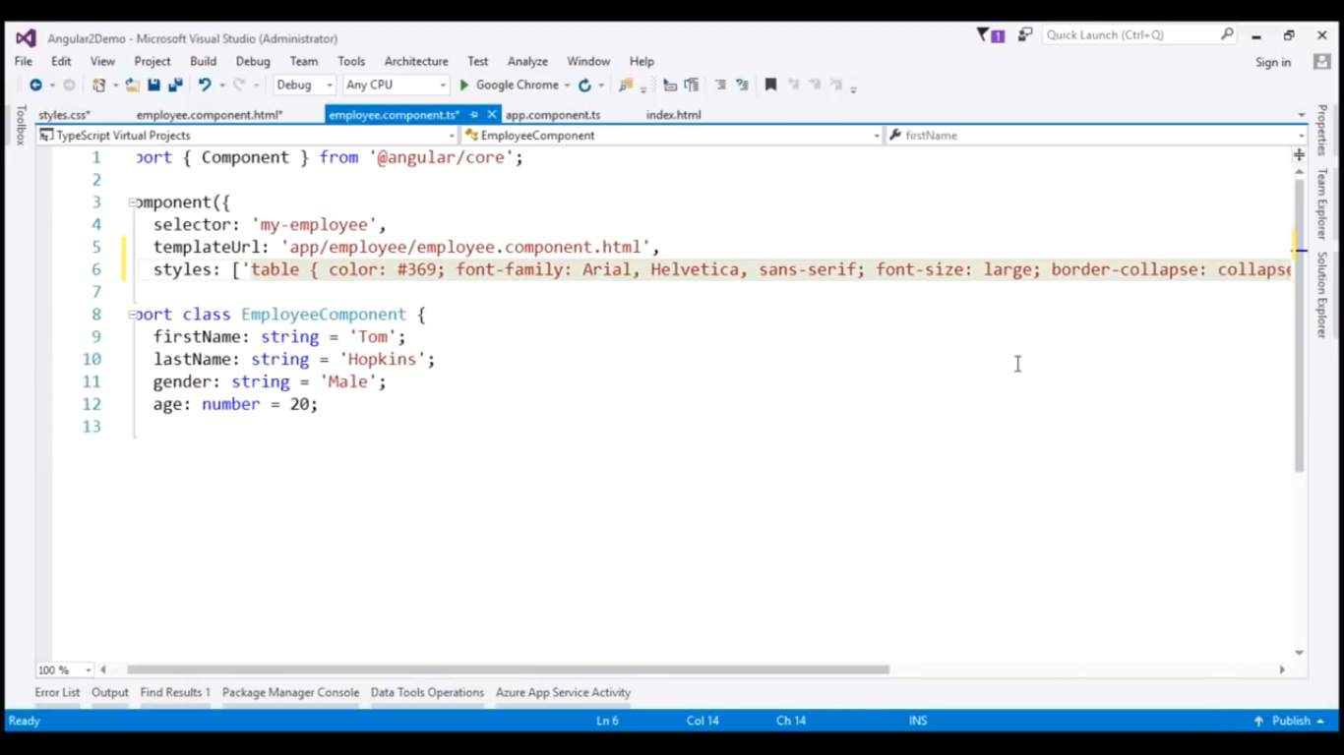
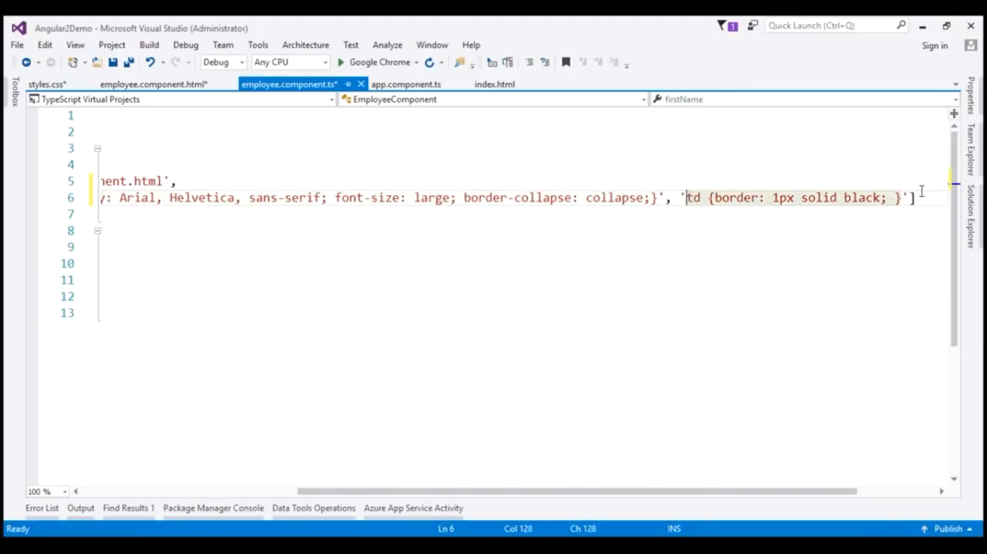
Example 1:- Specify the styles using the @component decorator styles property

Slide 56
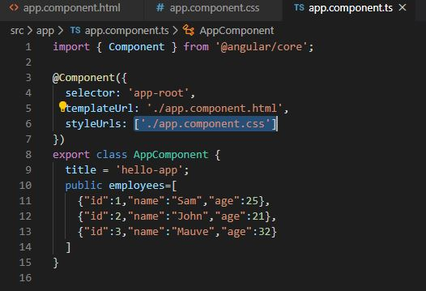
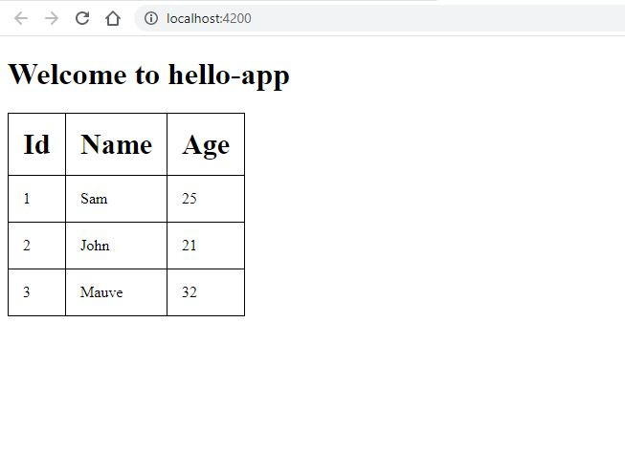
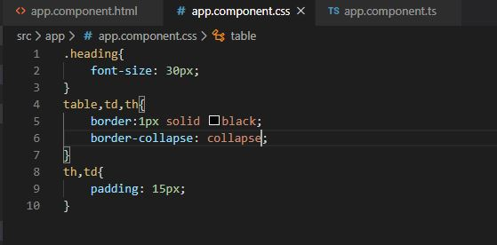
Example 1:- Specify the styles using the @component decorator styleUrls property

Slide 57
Interpolation : Data binding in angular

Slide 58
Interpolation
Interpolation means data banding.
Interpolation is represented using double-curly braces. Example- {{ }}
Using Interpolation we evaluate expressions. The component properties, mathematical calculation etc are executed within interpolation

Slide 59
Different types of data binding in angular
One way data-binding : From component to view template
One way data-binding : From view template to component
Two way data-binding : From component to view template and From view template to component

Slide 60
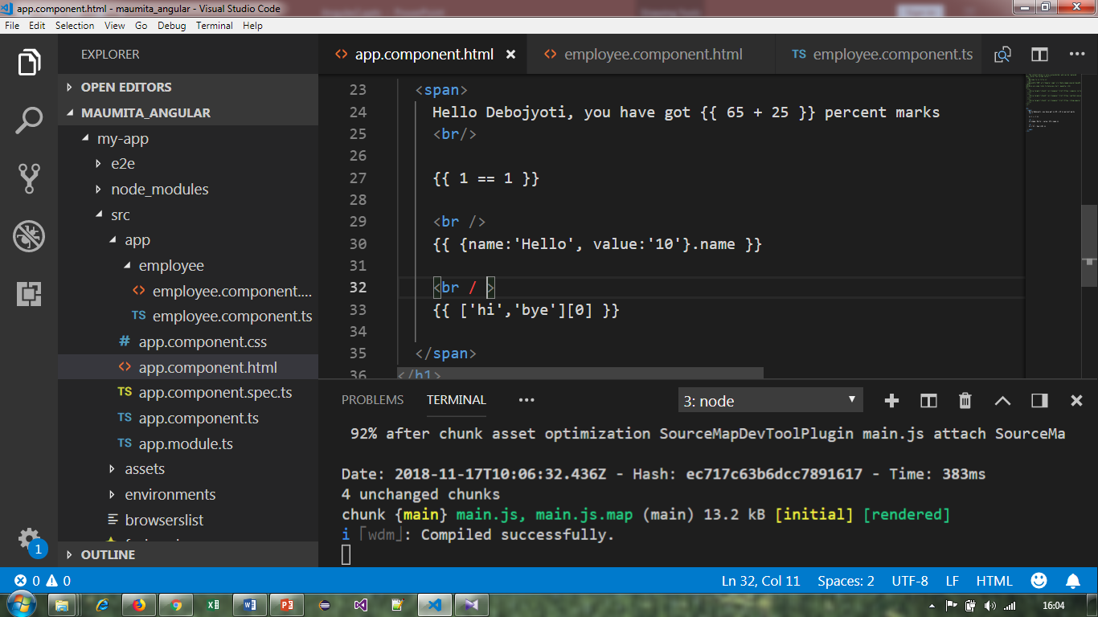
Example -1
Angular uses double-curly braces {{ }} to represent interpolation. Interpolation executes expression. Suppose we want to do mathematical calculation, we can perform it as follows within HTML template.

Slide 61
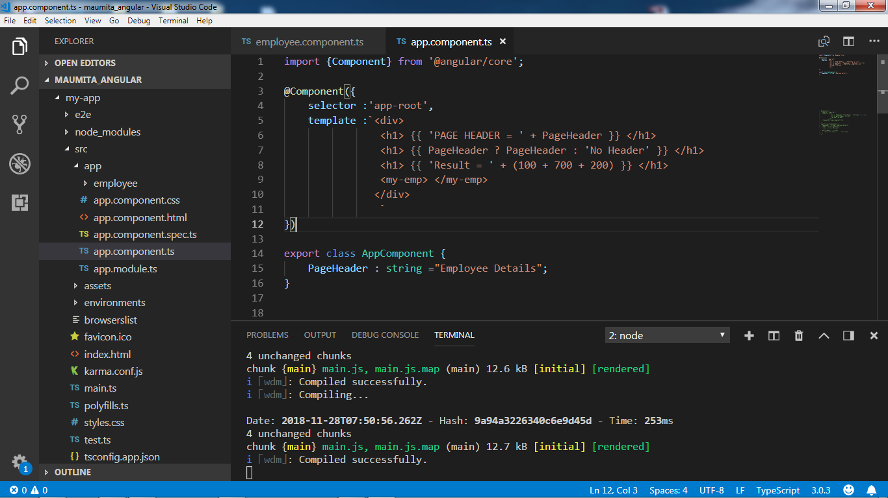
Example 2 –( Some operation of Interpolation)

Slide 62
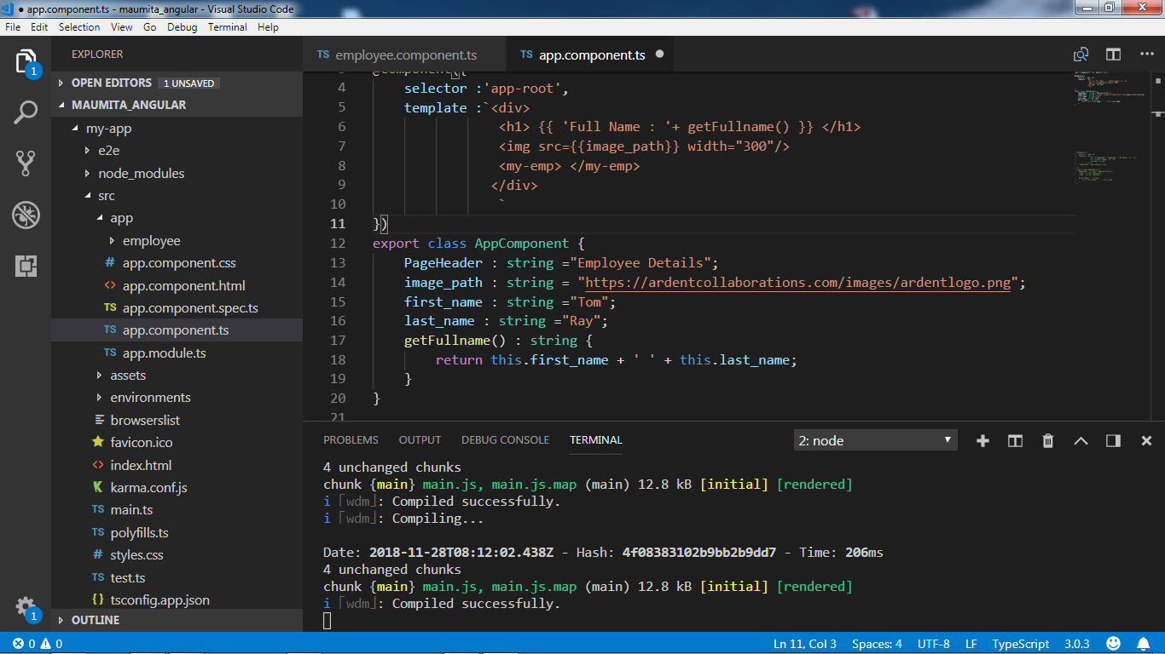
Example 3

Slide 63
Property binding

Slide 64
Interpolation vs Property binding
Interpolation :
This is one way data-binding.
Data will flow from class (Component) to template property (template / UI).
Interpolation is a special syntax that angular convert into property binding.
Interpolation is just convenient alternative of property binding.
To concatenate string we must use interpolation instead of property binding .
<img src="https://ardentcollaborations.com/{{image_path}}" width="300"/>
Property binding :
To set an element property to a non-string data value, we must use property binding not interpolation.
<button [disabled]='isDisable' >Click me for next page!!!</button>
export class AppComponent {
isDisable : boolean = true;
}

Slide 65
Continue…
In case of property binding : i) Remember to enclose the property name with pair of square brackets.
<img [src]='image_path' />
ii)Canonical form
<span bind-innerHtml='PageHeader'></span>
Property Binding Example
<img src="{{ angularLogo }}">
<img [src]="angularLogo">
<img bind-src="angularLogo">

Slide 66
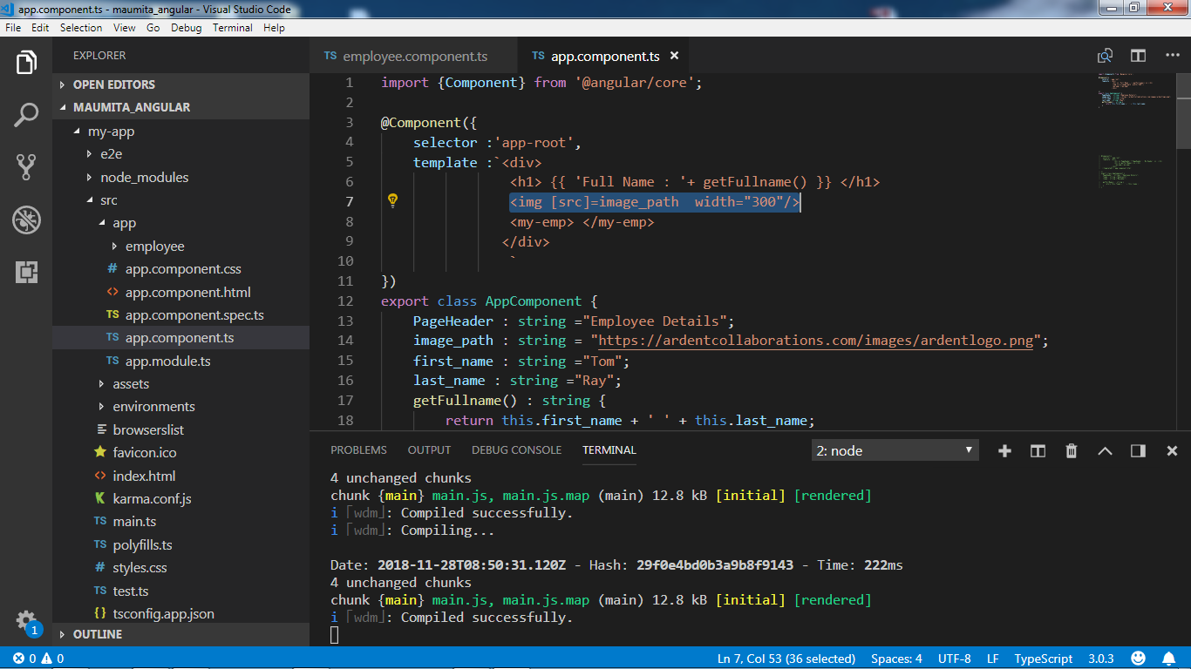
Example 1 (Property binding)

Slide 67
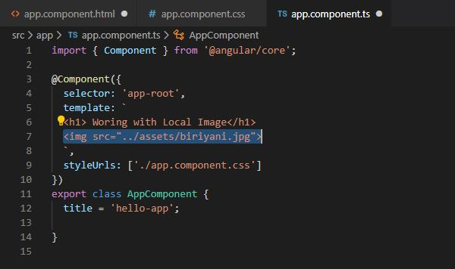
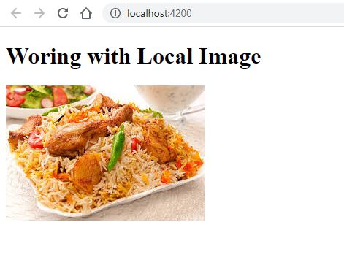
Working With Local Image(Keep the image in assets folder):

Slide 68
DOM Property && HTML Attribute

Slide 69
Working with DOM
DOM stands for Document Object Model.
When a browser loads a web page, browser creates a DOM of that page.
DOM contains the html elements as object,their propertics, methods and events and it is a standard for accessing,modifying,adding,deleting html elements.

Slide 70
Continue…
Attributes are defined by HTML where as properties are defined by DOM.
Attributes initialize DOM property.

Slide 71
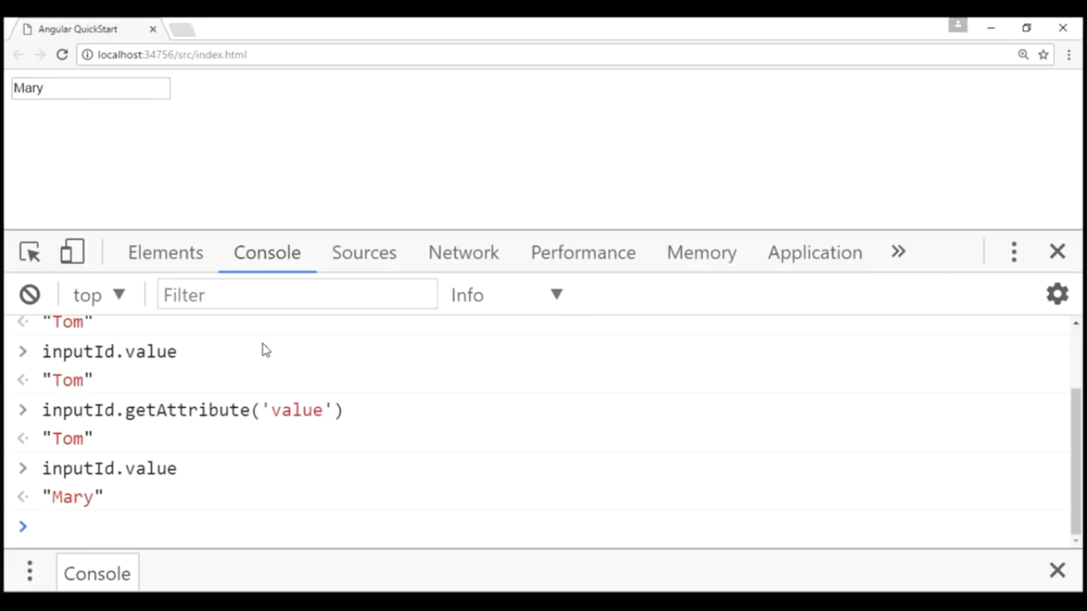
DOM Example 1

Slide 72
Attribute-binding

Slide 73
Angular Attribute-binding Concept
Attribute binding is to set the value of attribute directly.
We must use attribute binding when there is no element property to bind.
Pure attributes are those whose corresponding DOM property is not available.
Attributing binding should be performed with pure attributes such as ARIA, SVG and COLSPAN.

Slide 74
Attribute binding vs property binding
Attribute binding is performed in the same way as property binding with difference that in attribute binding we need to prefix attribute name with attr. keyword.
Angular 2 attribute binding is required in those cases when HTML attribute has no corresponding DOM property.

Slide 75
Attribute binding vs property binding
Attribute binding is same as property binding with the difference that we need to add attr. as prefix with attribute name. Here we will discuss attribute binding for colspan attribute of <td> element.
Suppose we have defined a property clspn with some numeric value in our component.
clspn = 2;
1. Find the attribute binding using bracket [ ].
<td [attr.colspan]="clspn">
2. Attribute binding using bind- keyword.
<td bind-attr.colspan = "clspn">
3. Attribute binding using interpolation.
<td attr.colspan = "{{clspn}}">

Slide 76


In the below mentioned example if we use Interpolation ,instead of attribute-binding

Slide 77

Declaring a data member into a class

Slide 78

Example 1

Slide 79
Event-Binding in Angular

Slide 80
About : Event-binding
The below mentioned binding examples, flow data in one direction i.e – from a component property(class) to an HTML element property (template) .
Interpolation
Property binding
Attribute binding
Class binding
Style binding
But incase of event binding, flow data in opposite direction i.e - from an HTML element to a component.

Slide 81


Example 1

Slide 82


Example 1 (Alternative syntax called canonical form)

Slide 83


Code : : Example 3

Slide 84


Output : : Example 3→ Event-binding & *ng-If directive

Slide 85
Two-way data binding

Slide 86

Example 1

Slide 87


Using ngModel directive

Slide 88
Directives in Angular

Slide 89

Angular app directives can be classified in 3 categories based on how they behave:
Component Directives
Structural Directives
Attribute Directives

Slide 90
Basics about : Angular directives
The Angular 8 directives are used to manipulate the DOM. By using Angular directives, you can change the appearance, behaviour or a layout of a DOM element. It also helps you to extend HTML.
Structural Directives: Structural directives start with a * sign. These directives are used to manipulate and change the structure of the DOM elements. For example, *ngIf directive, *ngSwitch directive, and *ngFor directive.
*ngIf Directive: The ngIf allows us to Add/Remove DOM Element.
*ngSwitch Directive: The *ngSwitch allows us to Add/Remove DOM Element. It is similar to switch statement of C#.
*ngFor Directive: The *ngFor directive is used to repeat a portion of HTML template once per each item from an iterable list (Collection).

Slide 91


Slide 92
ngIf - Structural directive
Structural directives are responsible for HTML layout. They shape or reshape the DOM's structure, typically by adding, removing, or manipulating elements.

Slide 93

Example - 1

Slide 94

Example – 2 : <h2> </h2> element is removed from DOM , if *ngIf=“false”

Slide 95
About : *ngFor directive
ngFor structural directive
ngFor one of the structural directive in angular.
ngFor is a directive that iterates over collection of data.
ngFor directive is to render a list of html elements.
It is used to customize data display.
ngFor can be used with asterisk(*) or template directive or template tag.

Slide 96

Example 1

Slide 97

Example 1 Continue…

Slide 98


Example 2 (*ngFor directive)

Slide 99


Example 3

Slide 100


Example 4

Slide 101


Example 5

Slide 102
About : *ngSwitch directive
ngFor one of the structural directive in angular.
NgFor is a directive that iterates over collection of data.
It is used to customize data display.
NgFor can be used with asterisk(*) or template directive or template tag.

Slide 103

Example - 1

Slide 104
About: Component Interaction
Component Interaction
Some of the situation a component needs to communicate or interact with other component.
The parent component might send some data to child component and vise-versa.
How do the component interact :: @Input() and @Output() decorators.

Slide 105

Component interaction between Parent and child component

Slide 106

Example 1 : Parent component = AppComponent (sender) child component = TestComponent (receiver)

Slide 107

Example 1 Way - 1 One way to receive parent data

Slide 108

Example 1 Way - 2 Another way to receive parent data

Slide 109

Example 2 : Part 1 (Using Events) Child component (TestComponent) → Parent (AppComponent)

Slide 110

Example 2 : Part 2

Slide 112

Case Study :- #1 : Expected Output

Slide 113


Example: #1

Slide 114

Example 1 continues

Slide 115


Slide 116


Slide 117


Slide 118


Slide 119


Slide 120


Slide 121


Slide 122


Slide 123


Slide 124


Slide 125
Angular Pipes & Custom pipes

Slide 126
About : Pipes in Angular
Angular pipes are the way to write display-value transformations that you can declare in your HTML component.
Angular Pipes were earlier called filters in AngularJS and called pipes from Angular 2 onwards. The pipe takes the data as input and transforms it the desired output.

Slide 127
About : Pipes in Angular
Pipes transform data before display.
Built in pipes include lowercase ,uppercase ,date ,percent ,decimal ,currency etc.
How to apply a pipe on a bound property
Example :- <td>{{ employee.code | uppercase }}</td>
Pipe character “ | “
We can also chain pipes :
Example :- <td>{{ employee.dob | date:'dd/MM/yyyy' | uppercase }}</td>
Pass Parameters to pipes using colon “ : “
Example :- {{ employee.annualSalary | currency:'USD':true:'1.1-3’ }}
We can also create custom pipes.

Slide 128
Example : #1: Pipes
<tbody>
<tr *ngFor="let employee of employees">
<td>{{ employee.code | uppercase }}</td>
<td>{{ employee.name }} </td>
<td>{{ employee.gender }} </td>
<td>{{ employee.annualSalary | currency:'USD':true:'1.1-3' }}</td>
<td>{{ employee.dob | date:'dd/MM/yyyy' | uppercase }}</td>
<!-- <td>{{ employee.dob | date:'fullDate' | uppercase }}</td> bydefault 'fullDate' value-- MM/dd/yyyy - date format -->
</tr>
<tr *ngIf="!employees || employees.length==0">
<td colspan="5">No Employees to display...</td>
</tr>
</tbody>

Slide 129

Example :- #2 : Built-in Pipes

Slide 130

Example 2 : Output

Slide 131
About : Custom pipe
Angular has many Pipes built-in, but they only take us so far. Ideally we’d like to extend our applications by creating custom Pipes.
Custom Pipes (previously Filters in AngularJS) allow us to essentially create a pure function, which accepts an input and returns a different output via some form of transformation.
That’s the essence of a Pipe. And we see this already in Angular with things like the Date Pipe and friends.

Slide 132

Expected Output_#1: Custom Pipe

Slide 133


Custom pipe – Example -1

Slide 134

Expected Output_#2 - Custom pipe

Slide 135
Example 2 : app.sqrt.ts
import {Pipe, PipeTransform} from '@angular/core';
@Pipe ({
name : 'sqrt'
})
export class SqrtPipe implements PipeTransform {
transform(val : number) : number {
return Math.sqrt(val);
}
}

Slide 136

Example 2 : app.module.ts.

Slide 137

app.component.html

Slide 138
Service in Angular

Slide 139

About: Services in Angular
Service is a class with a specific purpose.
Uses of Service class in Angular
Share data.
Implement application logic.
External interaction.
Naming convention -- .service.ts

Slide 140


Example-1:- Services in Angular

Slide 141

To display the emp full details in a separate view Idea-1: (With-out service class)

Slide 142

Idea-1 Violating
A component class in angular should have only one responsibility.

Slide 143

Idea-2 : How to overcome or Solution of this problem

Slide 144

Service Steps:

Slide 145


Service Example: 1. Generate Service( ng g s services) 2. Add a method in our example getEmployee()

Slide 146


Service Example continue…

Slide 147

Service Example continue…

Slide 148
Angular Routing concept

Slide 149
Routing & Navigation
Routing allows you to navigate from one view to another view.
The Angular Router enables navigation from one view to the next as users perform application tasks.

Slide 150


Slide 151


Example-1 Step-1

Slide 152

Step-1 : Continue…

Slide 153



Step-2

Slide 154

Step-3

Slide 155

Step-3 : Continue

Slide 156

Step-4

Slide 157

Example-2 Wildcard Route

Slide 158

Example-3 Default Route

Slide 159


pathMatch:’full’ && pathMatch:’prefix’

Slide 160
Angular Forms (ngForm)

Slide 161

Angular Forms
Forms play a very important role in an application.
Example – [sign-up page, login page ,to take any input from user etc.

Slide 162


Slide 163

Task of a Forms

Slide 164

Creating a Form: Step -1: Go to https://getbootstrap.com/docs/4.4/getting-started/introduction/ and copy the css and paste in index.html

Slide 165


Step 2- Write content in html

Slide 166


Slide 167
Thank you…

